Slide 1
Problem Statement Description
LOWE’S HACKATHON
The current retail store in India are not automatic .The traditional method takes a lot of time.
Proposal is to device a solution that will automate the process and will help in saving time and human effort.
In present shopping system, searching a product is quite tiring, especially in large stores, and time consuming.
The proposed solution Is to navigate the customer through the best possible route. The route will be designed in a manner, so that the customer is able to get all the enlisted products( the list of products given by the user ) with the best possible deals, available at that time.
PROBLEM STATEMENT : Build a solution to help customers find products in the store and help them navigate to the corresponding shelf. If there is a shopping list , provide the best shopping trip to complete the purchases.
PROBLEM STATEMENT No : 3
TEAM NAME : MILTON
TEAM LEADER NAME : ABHINAV RASTOGI
TEAM MEMBERS : DEVESH GULWANI, ARSH GOYAL

Slide 2
Project Overview
Check-In:
Each customer issues a cart / trolley while entering into the mall/store.
The customer then connects to store/mall wifi which prompts to provide the following details-
1) The Cart Number.
2) Customer ID/Details( Mobile Number, Lowe’s Store/Account ID).
After this the Customer gets an OTP for authentication to connect.
After connecting, the Customer is directed to an UI on his Mobile.
If the Customer has already entered the Items to be purchased in his Lowe’s Account Cart (Online), then The provided UI automatically enlists the Items in his cart and provides Adding option to the customer for adding more items.
Then a continue option is prompted.

Slide 3
Project Overview
Navigation and Assistance:
Customer is then provided with the best route to pick-up all the enlisted products in the shortest and best possible way.
The Navigation is done with the help of mobile itself, with the help of the stores map.
Along with the Navigation the Mobile UI provides a chat-bot, which helps the customer in grabbing the best possible deals on the enlisted products.
Customer can also select to have Store’s Service-Staff Assistance.
Check-Out:
After adding all the required items to the cart, a checkout screen will be generated on his UI and will be redirected to the Lowe’s website to checkout.
After successful completion of online payment, a receipt is generated at the billing counter.
After verifying the products at the billing counter, his journey completes.

Slide 4
Working
The shopping list is synced with the customer’s Lowe’s ID.
The navigation process includes various algorithms such as Dijkstra Algorithm, A-star Algorithm.
The UI is synced with the Item’s List by giving an API call to the Lowe’s account database( Online Shopping Cart ) with the provided Customer-ID and mobile number.
Also we are using the Store’s database for the locations(store/shelf) of the all the products in the store.
We are using Modified A-star algorithm to get the best route to pick all the enlisted products.
Path is computed not only on the basis of shortest path, but also according to user’s preferences and his past history purchase.
As soon as the person switches on the wifi of hi phone, the wifi installed at the store is connected to his phone.
This connection between the wifi nodes can be made by modifying the code structure installed in the wifi.

Slide 5
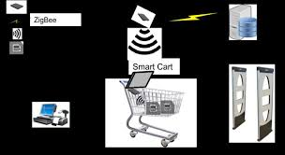
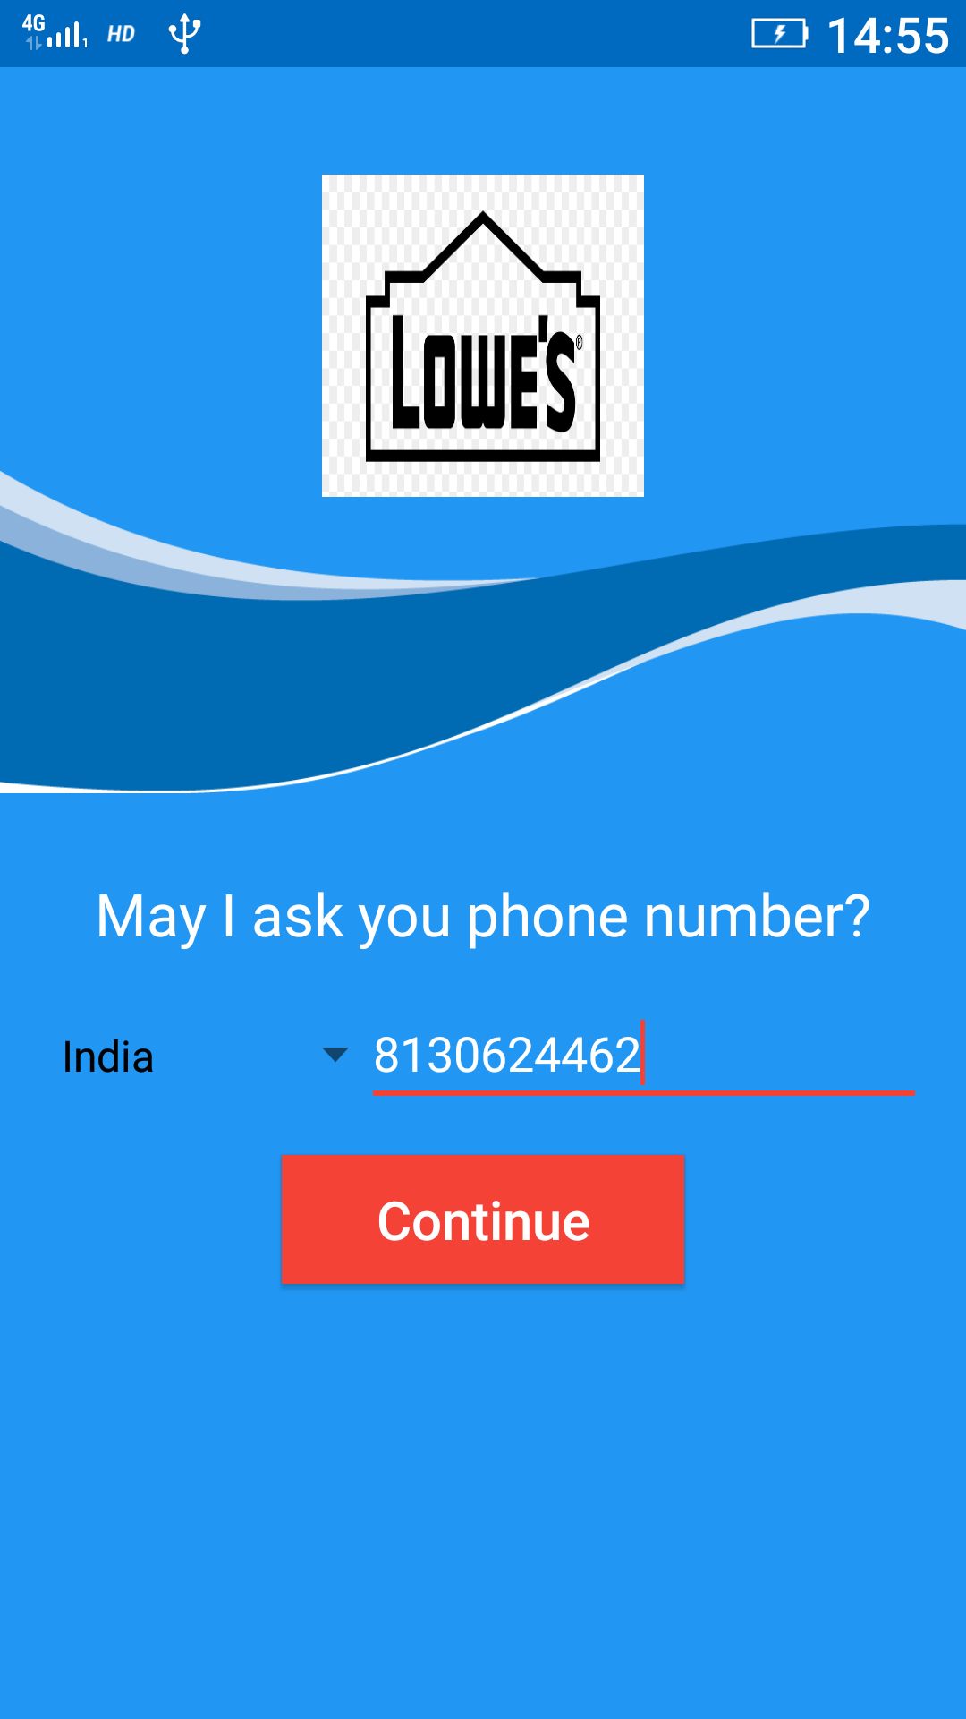

Slide 6
